Slide 1
Google Sites
Make a website easily
By : EasySlides (NishWeb)
Please view the full presentation for a nice tutorial.

Slide 2
Step 1
Go to sites.google.com

Slide 3
Suggested: Do and view
This is a tutorial, edit as well as view this presentation together for best results.

Slide 4
Click on BLANK

Slide 5
Welcome Screen

Slide 6
Add Content

Slide 7
Add content
Click on Your Page Title and edit.

Slide 8
Add information using the Insert tab.

Slide 9
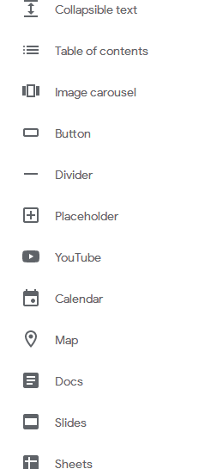
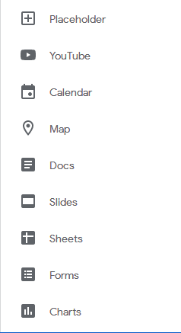
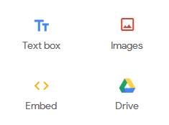
Add text, images, embeds, forms, maps, files etc.

Slide 10
Pages

Slide 11
Pages are used to separate content between the website.
They are visible as separate tabs, and each tab is a new page, where you can add content.
They are all linked together, and are united as one website.

Slide 12
Add a page
Go to pages tab

Slide 13
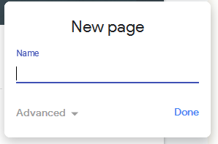
Name the page

Slide 14
It will appear as a new page.

Slide 15
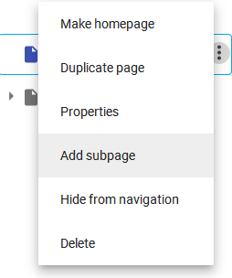
Subpages
Simillar to a subfolder

Slide 17
Publishing
Make the new website available online to all
Click here

Slide 18
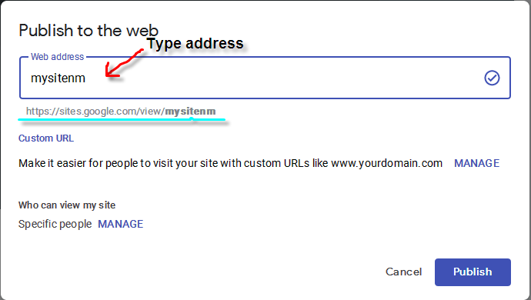
Click on Publish

Slide 19
Errors of publishing
Address already used so can not be used again.

Slide 20
Short Address

Slide 21
Forbidden Word

Slide 22
Reserved address

Slide 23
Click on publish

Slide 24
SEO
Search Engine Optimisation
Make your site available on Google
“The easiest SEO setup “

Slide 25
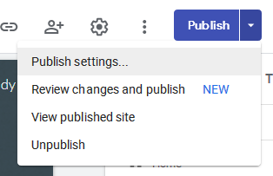
Click on drop-down arrow near publish and click on Publish Settings

Slide 26
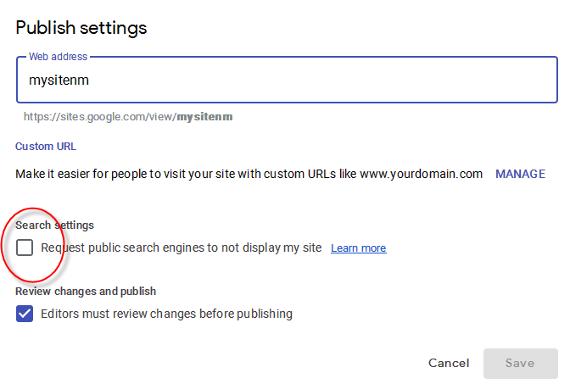
Check/Uncheck the option
Google YES

Slide 27
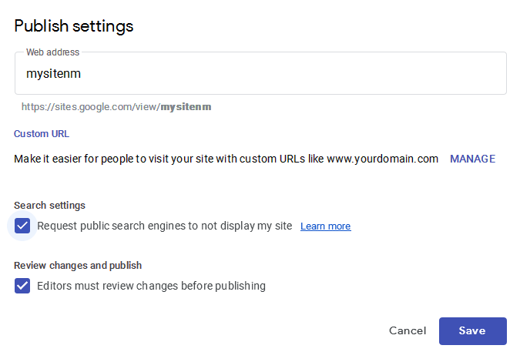
Not visible in Google

Slide 28
SAVE

Slide 29
Advanced

Slide 30
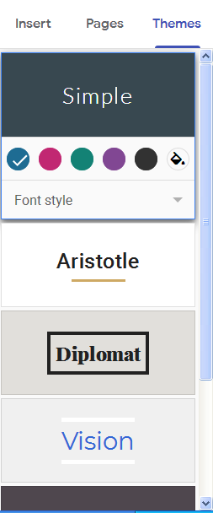
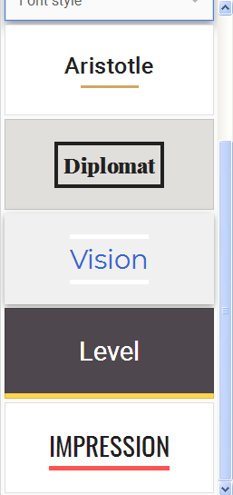
Themes
Choose between 6 unique themes

Slide 31
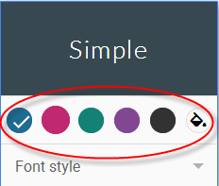
Color

Slide 32
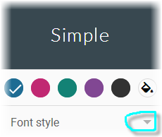
Font

Slide 33
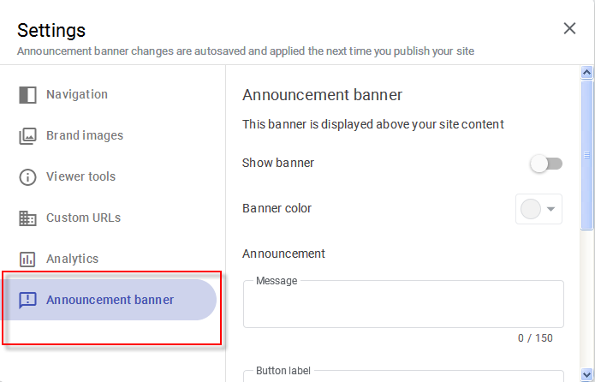
Announcement Banner
Settings
Announcement Banner

Slide 34
Add some text and a button

Slide 35
Sections

Slide 36
Sections are
Divisions on a single webpage.
They are rectangular spaces where text, images etc. can be inserted.
We can format the section easily.

Slide 37
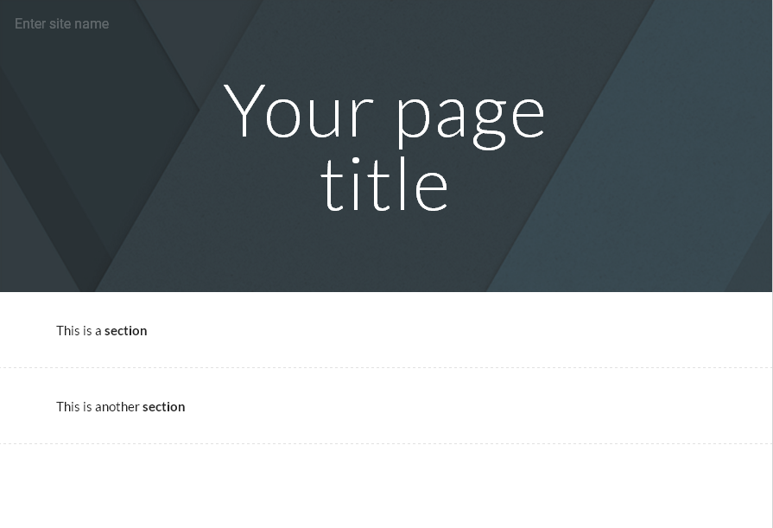

Slide 38
On hovering on the left side of the section

Slide 39
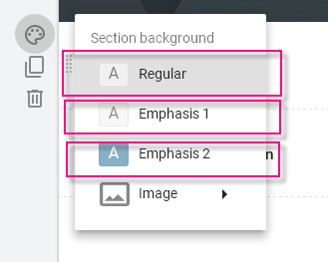
Change Background of the section
Colour
Google Sites allow use of 3 background colours of a section.

Slide 40
Emphasis 2: Theme colour

Slide 41
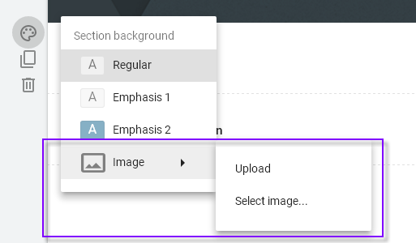
Background Image of section

Slide 42
Upload image: Upload image from computer
Select image: Use online images for background.

Slide 43
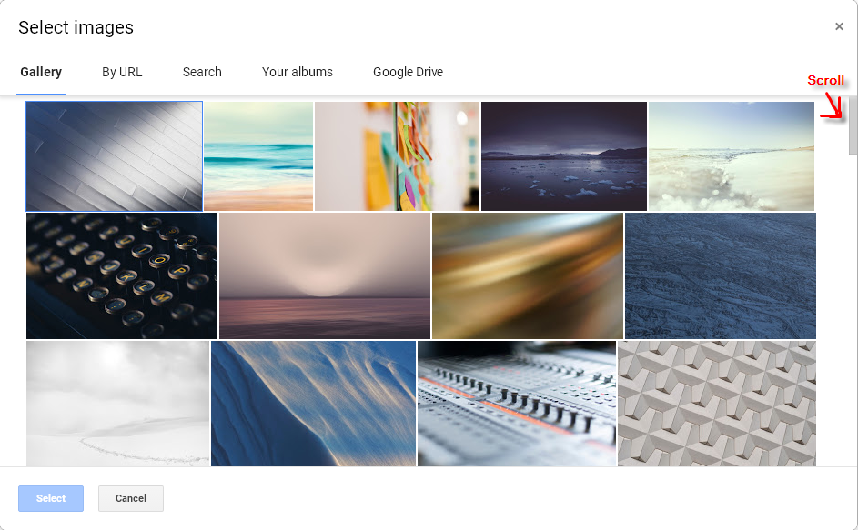
Select Image
Google Sites Gallary

Slide 44
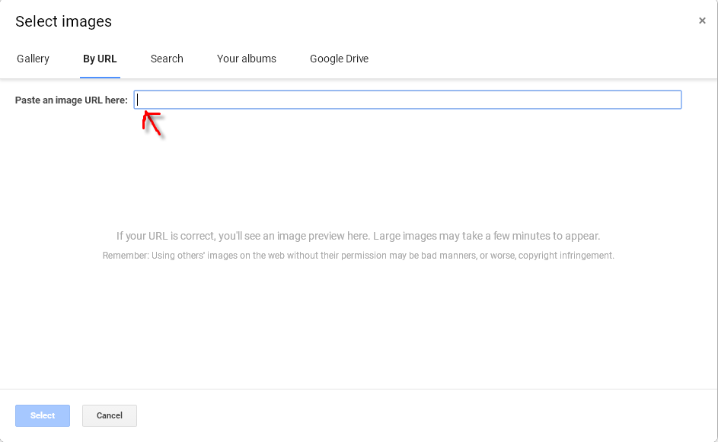
URL
Paste URL of online image

Slide 45
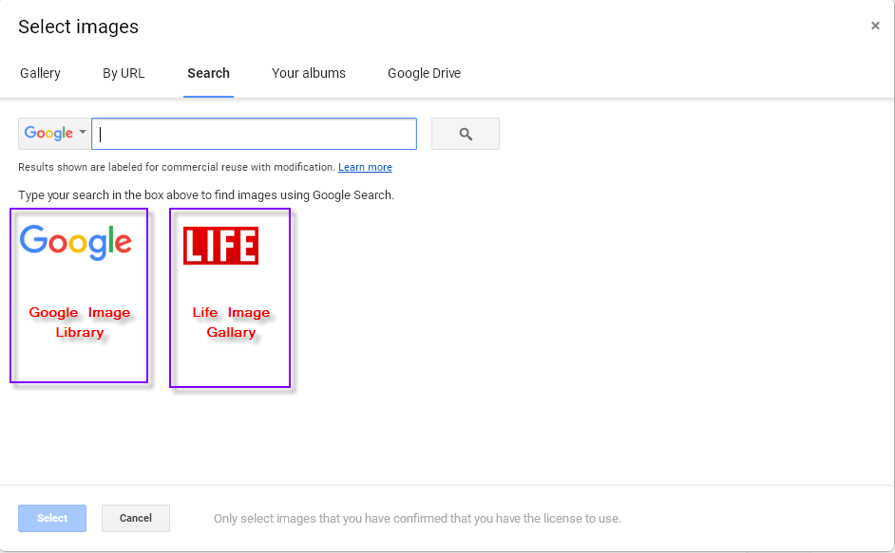
Search
Search means Google Clipart Library.

Slide 46
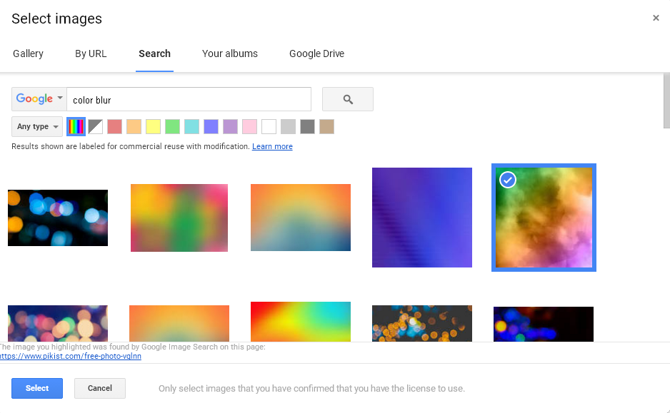
An awesome section

Slide 48
Site title
HTML script (regular, for making a normal website.
<head>
<title>Page Title</title>
</head>

Slide 49
Using Google Sites

Slide 50
Quick Note

Slide 51
Publish the site ☺☺☺☺☺☺☺☺
Note: After every change, it is saved to Drive, but not published to be viewable by all. Click publish every time you want to make the changes public.

Slide 52
Tracking
This is used to track the following of your visitors:
Device (mobile,tablet,PC)
OS
Browser(Firefox, Edge, Chrome)
Duration of visit
Which pages visitor visits
Location
AND MUCH MORE

Slide 53
Google Analytics

Slide 54
Tracking will be discussed in another presentation.

Slide 55
Made by NISHWEB

Slide 56
Thank You

